Slide 1
18-447 Computer Architecture Lecture 22: Memory Controllers
Prof. Onur Mutlu
Carnegie Mellon University
Spring 2015, 3/25/2015

Slide 2
Lab 4 Grades
Mean: 89.7
Median: 94.3
Standard Deviation: 16.2

Slide 3
Lab 4 Extra Credit
Pete Ehrett (fastest) – 2%
Navneet Saini (2nd fastest) – 1%

Slide 4
Announcements (I)
No office hours today
Hosting a seminar in this room right after this lecture
Swarun Kumar, MIT, “Pushing the Limits of Wireless Networks: Interference Management and Indoor Positioning”
March 25, 2:30-3:30pm, HH 1107
From talk abstract:
(…) perhaps our biggest expectation from modern wireless networks is faster communication speeds. However, state-of-the-art Wi-Fi networks continue to struggle in crowded environments — airports and hotel lobbies. The core reason is interference — Wi-Fi access points today avoid transmitting at the same time on the same frequency, since they would otherwise interfere with each other. I describe OpenRF, a novel system that enables today’s Wi-Fi access points to directly combat this interference and demonstrate significantly faster data-rates for real applications.

Slide 5
Today’s Seminar on Flash Memory (4-5pm)
March 25, Wednesday, CIC Panther Hollow Room, 4-5pm
Yixin Luo, PhD Student, CMU
Data Retention in MLC NAND Flash Memory: Characterization, Optimization and Recovery
Yu Cai, Yixin Luo, Erich F. Haratsch, Ken Mai, and Onur Mutlu, "Data Retention in MLC NAND Flash Memory: Characterization, Optimization and Recovery" Proceedings of the 21st International Symposium on High-Performance Computer Architecture (HPCA), Bay Area, CA, February 2015. [Slides (pptx) (pdf)] Best paper session.
http://users.ece.cmu.edu/~omutlu/pub/flash-memory-data-retention_hpca15.pdf

Slide 6
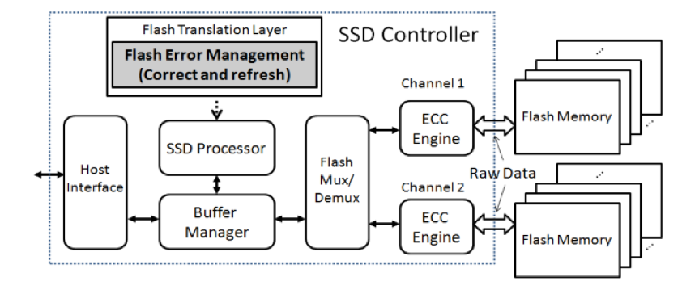
Flash Memory (SSD) Controllers
Similar to DRAM memory controllers, except:
They are flash memory specific
They do much more: error correction, garbage collection, page remapping, …
Cai+, “Flash Correct-and-Refresh: Retention-Aware Error Management for Increased Flash Memory Lifetime”, ICCD 2012.

Slide 7
Where We Are in Lecture Schedule
The memory hierarchy
Caches, caches, more caches
Virtualizing the memory hierarchy: Virtual Memory
Main memory: DRAM
Main memory control, scheduling
Memory latency tolerance techniques
Non-volatile memory
Multiprocessors
Coherence and consistency
Interconnection networks
Multi-core issues

Slide 8
Required Reading (for the Next Few Lectures)
Onur Mutlu, Justin Meza, and Lavanya Subramanian, "The Main Memory System: Challenges and Opportunities" Invited Article in Communications of the Korean Institute of Information Scientists and Engineers (KIISE), 2015.
http://users.ece.cmu.edu/~omutlu/pub/main-memory-system_kiise15.pdf

Slide 9
Required Readings on DRAM
DRAM Organization and Operation Basics
Sections 1 and 2 of: Lee et al., “Tiered-Latency DRAM: A Low Latency and Low Cost DRAM Architecture,” HPCA 2013.
http://users.ece.cmu.edu/~omutlu/pub/tldram_hpca13.pdf
Sections 1 and 2 of Kim et al., “A Case for Subarray-Level Parallelism (SALP) in DRAM,” ISCA 2012.
http://users.ece.cmu.edu/~omutlu/pub/salp-dram_isca12.pdf
DRAM Refresh Basics
Sections 1 and 2 of Liu et al., “RAIDR: Retention-Aware Intelligent DRAM Refresh,” ISCA 2012. http://users.ece.cmu.edu/~omutlu/pub/raidr-dram-refresh_isca12.pdf

Slide 10
Memory Controllers

Slide 11
DRAM versus Other Types of Memories
Long latency memories have similar characteristics that need to be controlled.
The following discussion will use DRAM as an example, but many scheduling and control issues are similar in the design of controllers for other types of memories
Flash memory
Other emerging memory technologies
Phase Change Memory
Spin-Transfer Torque Magnetic Memory
These other technologies can place other demands on the controller

Slide 12
DRAM Types
DRAM has different types with different interfaces optimized for different purposes
Commodity: DDR, DDR2, DDR3, DDR4, …
Low power (for mobile): LPDDR1, …, LPDDR5, …
High bandwidth (for graphics): GDDR2, …, GDDR5, …
Low latency: eDRAM, RLDRAM, …
3D stacked: WIO, HBM, HMC, …
…
Underlying microarchitecture is fundamentally the same
A flexible memory controller can support various DRAM types
This complicates the memory controller
Difficult to support all types (and upgrades)

Slide 13
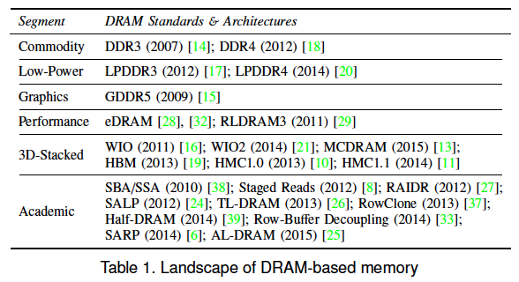
DRAM Types (II)
Kim et al., “Ramulator: A Fast and Extensible DRAM Simulator,” IEEE Comp Arch Letters 2015.

Slide 14
DRAM Controller: Functions
Ensure correct operation of DRAM (refresh and timing)
Service DRAM requests while obeying timing constraints of DRAM chips
Constraints: resource conflicts (bank, bus, channel), minimum write-to-read delays
Translate requests to DRAM command sequences
Buffer and schedule requests to for high performance + QoS
Reordering, row-buffer, bank, rank, bus management
Manage power consumption and thermals in DRAM
Turn on/off DRAM chips, manage power modes

Slide 15
DRAM Controller: Where to Place
In chipset
+ More flexibility to plug different DRAM types into the system
+ Less power density in the CPU chip
On CPU chip
+ Reduced latency for main memory access
+ Higher bandwidth between cores and controller
More information can be communicated (e.g. request’s importance in the processing core)

Slide 16
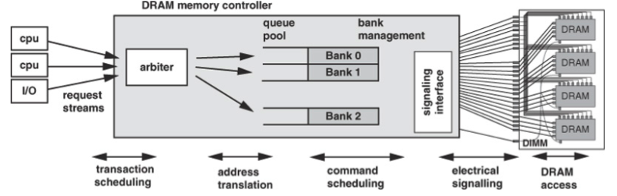
A Modern DRAM Controller (I)

Slide 17
A Modern DRAM Controller (II)

Slide 18
DRAM Scheduling Policies (I)
FCFS (first come first served)
Oldest request first
FR-FCFS (first ready, first come first served)
1. Row-hit first
2. Oldest first
Goal: Maximize row buffer hit rate → maximize DRAM throughput
Actually, scheduling is done at the command level
Column commands (read/write) prioritized over row commands (activate/precharge)
Within each group, older commands prioritized over younger ones

Slide 19
DRAM Scheduling Policies (II)
A scheduling policy is a request prioritization order
Prioritization can be based on
Request age
Row buffer hit/miss status
Request type (prefetch, read, write)
Requestor type (load miss or store miss)
Request criticality
Oldest miss in the core?
How many instructions in core are dependent on it?
Will it stall the processor?
Interference caused to other cores
…

Slide 20
Row Buffer Management Policies
Open row
Keep the row open after an access
+ Next access might need the same row → row hit
-- Next access might need a different row → row conflict, wasted energy
Closed row
Close the row after an access (if no other requests already in the request buffer need the same row)
+ Next access might need a different row → avoid a row conflict
-- Next access might need the same row → extra activate latency
Adaptive policies
Predict whether or not the next access to the bank will be to the same row

Slide 21
Open vs. Closed Row Policies
Policy | First access | Next access | Commands needed for next access
Open row | Row 0 | Row 0 (row hit) | Read
Open row | Row 0 | Row 1 (row conflict) | Precharge + Activate Row 1 + Read
Closed row | Row 0 | Row 0 – access in request buffer (row hit) | Read
Closed row | Row 0 | Row 0 – access not in request buffer (row closed) | Activate Row 0 + Read + Precharge
Closed row | Row 0 | Row 1 (row closed) | Activate Row 1 + Read + Precharge

Slide 22
Memory Interference and Scheduling in Multi-Core Systems

Slide 23
Review: A Modern DRAM Controller

Slide 24
Review: DRAM Bank Operation
Access Address:
(Row 0, Column 0)
Columns
(Row 0, Column 1)
(Row 0, Column 85)
(Row 1, Column 0)
Row address 0
Row address 1
Row decoder
Rows
Row Buffer
CONFLICT !
HIT
Row 1
HIT
Row 0
Empty
Column address 0
Column mux
Column address 0
Column address 1
Column address 85
Data

Slide 25
Scheduling Policy for Single-Core Systems
A row-conflict memory access takes significantly longer than a row-hit access
Current controllers take advantage of the row buffer
FR-FCFS (first ready, first come first served) scheduling policy
1. Row-hit first
2. Oldest first
Goal 1: Maximize row buffer hit rate → maximize DRAM throughput
Goal 2: Prioritize older requests → ensure forward progress
Is this a good policy in a multi-core system?

Slide 26
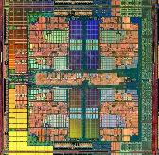
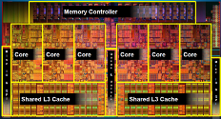
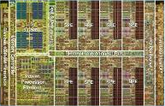
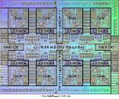
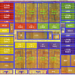
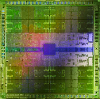

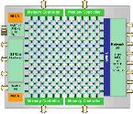
Trend: Many Cores on Chip
Simpler and lower power than a single large core
Large scale parallelism on chip
Intel Core i7 8 cores
IBM Cell BE 8+1 cores
IBM POWER7
8 cores
AMD Barcelona
4 cores
Nvidia Fermi
448 “cores”
Intel SCC
48 cores, networked
Tilera TILE Gx
100 cores, networked
Sun Niagara II
8 cores

Slide 27
Many Cores on Chip
What we want:
N times the system performance with N times the cores
What do we get today?

Slide 28
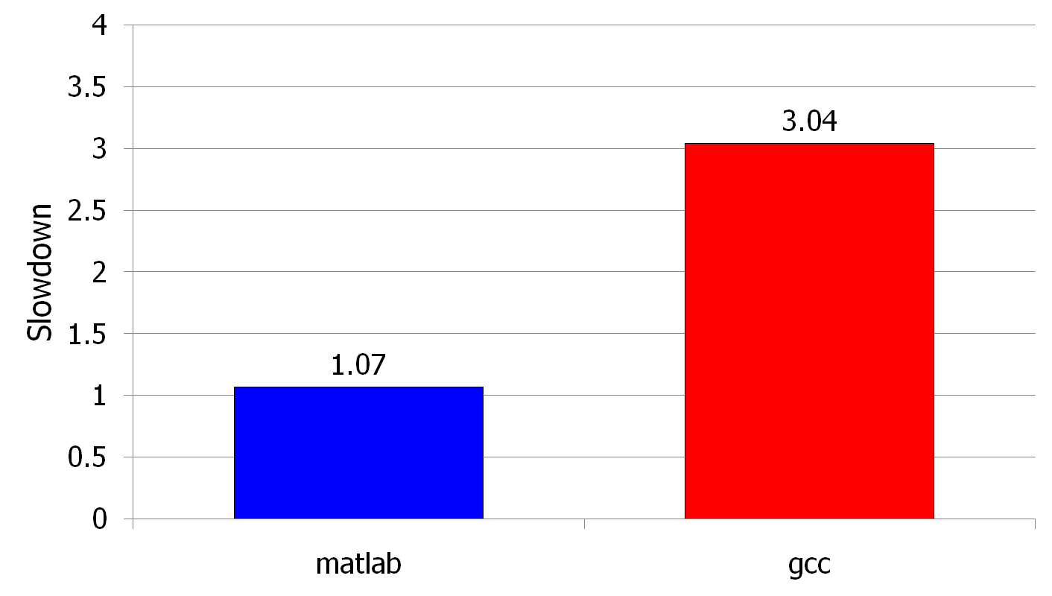
(Un)expected Slowdowns in Multi-Core
High priority
Low priority
(Core 0)
(Core 1)
Moscibroda and Mutlu, “Memory performance attacks: Denial of memory service
in multi-core systems,” USENIX Security 2007.
Notes:
What kind of performance do we expect when we run two applications on a multi-core system? To answer this question, we performed an experiment. We took two applications we cared about, ran them together on different cores in a dual-core system, and measured their slowdown compared to when each is run alone on the same system. This graph shows the slowdown each app experienced. (DATA explanation…)
Why do we get such a large disparity in the slowdowns?
Is it the priorities? No. We went back and gave high priority to gcc and low priority to matlab. The slowdowns did not change at all. Neither the software or the hardware enforced the priorities.
Is it the contention in the disk? We checked for this possibility, but found that these applications did not have any disk accesses in the steady state. They both fit in the physical memory and therefore did not interfere in the disk.
What is it then? Why do we get such large disparity in slowdowns in a dual core system?
I will call such an application a “memory performance hog”
Now, let me tell you why this disparity in slowdowns happens.
Is it that there are other applications or the OS interfering with gcc, stealing its time quantums? No.

Slide 29
Uncontrolled Interference: An Example
CORE 1
random
Multi-Core
Chip
stream
CORE 2
L2
CACHE
L2
CACHE
unfairness
INTERCONNECT
Shared DRAM
Memory System
DRAM MEMORY CONTROLLER
DRAM
Bank 0
DRAM
Bank 1
DRAM
Bank 2
DRAM
Bank 3
Notes:
-In a multi-core chip, different cores share some hardware resources. In particular, they share the DRAM memory system. The shared memory system consists of this and that.
When we run matlab on one core, and gcc on another core, both cores generate memory requests to access the DRAM banks. When these requests arrive at the DRAM controller, the controller favors matlab’s requests over gcc’s requests. As a result, matlab can make progress and continues generating memory requests. These requests are again favored by the DRAM controller over gcc’s requests. Therefore, gcc starves waiting for its requests to be serviced in DRAM whereas matlab makes very quick progress as if it were running alone.
Why does this happen? This is because the algorithms employed by the DRAM controller are unfair.
But, why are these algorithms unfair? Why do they unfairly prioritize matlab accesses?
To understand this, we need to understand how a DRAM bank operates.
Almost all systems today contain multi-core chips
Multi-core systems consist of multiple on-chip cores and caches
Cores share the DRAM memory system
DRAM memory system consists of
DRAM banks that store data (multiple banks to allow parallel accesses)
DRAM memory controller that mediates between cores and DRAM memory
It schedules memory operations generated by cores to DRAM
This talk is about exploiting the unfair algorithms in the memory controllers to perform denial of service to running threads
To understand how this happens, we need to know about how each DRAM bank operates

Slide 30
A Memory Performance Hog
// initialize large arrays A, B
for (j=0; j<N; j++) {
index = j*linesize;
A[index] = B[index];
…
}
// initialize large arrays A, B
for (j=0; j<N; j++) {
index = rand();
A[index] = B[index];
…
}
streaming
random
STREAM
RANDOM
Sequential memory access
Very high row buffer locality (96% hit rate)
Memory intensive
Random memory access
Very low row buffer locality (3% hit rate)
Similarly memory intensive
Moscibroda and Mutlu, “Memory Performance Attacks,” USENIX Security 2007.
Notes:
Streaming through memory by performing operations on two 1D arrays.
Sequential memory access
Each access is a cache miss (elements of array larger than a cache line size) → hence, very memory intensive
Link to the real code…

Slide 31
What Does the Memory Hog Do?
Row decoder
T0: Row 0
T0: Row 0
T0: Row 0
T0: Row 0
T0: Row 0
T0: Row 0
T0: Row 0
T1: Row 5
T1: Row 111
T0: Row 0
T1: Row 16
T0: Row 0
Memory Request Buffer
Row 0
Row Buffer
Row 0
Column mux
Row size: 8KB, cache block size: 64B
128 (8KB/64B) requests of T0 serviced before T1
T0: STREAM
T1: RANDOM
Data
Moscibroda and Mutlu, “Memory Performance Attacks,” USENIX Security 2007.
Notes:
Pictorially demonstrate how stream denies memory service to rdarray
Stream continuously accesses columns in row 0 in a streaming manner (streams through a row after opening it)
In other words almost all its requests are row-hits
RDarray’s requests are row-conflicts (no locality)
The DRAM controller reorders streams requests to the open row over other requests (even older ones) to maximize DRAM throughput
Hence, rdarray’s requests do not get serviced as long as stream is issuing requests at a fast-enough rate
In this example, the red thread’s request to another row will not get serviced until stream stops issuing a request to row 0
With those parameters, 128 requests of stream would be serviced before 1 from rdarray
As row-buffer size increases, which is the industry trend, this problem will become more severe
This is not the worst case, but it is easy to construct and understand
Stream falls off the row buffer at some point
I leave it to the listeners to construct a case worse than this (it is possible)

Slide 32
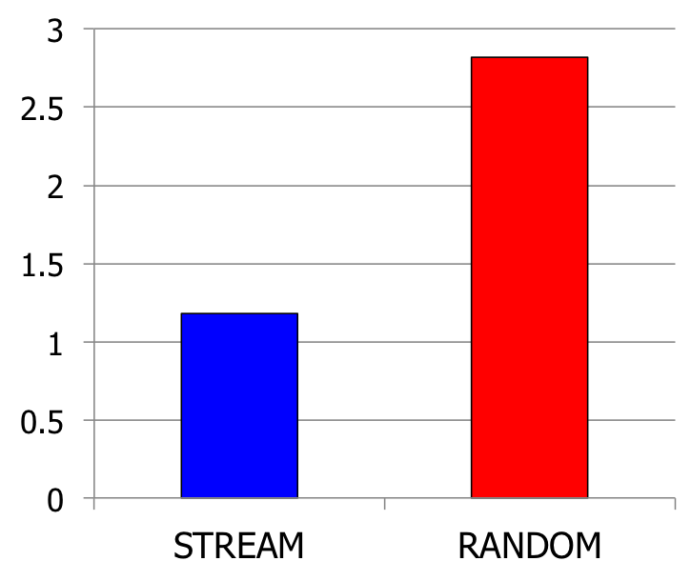
Effect of the Memory Performance Hog
2.82X slowdown
Slowdown
1.18X slowdown
Results on Intel Pentium D running Windows XP
(Similar results for Intel Core Duo and AMD Turion, and on Fedora Linux)
Moscibroda and Mutlu, “Memory Performance Attacks,” USENIX Security 2007.
Notes:
RANDOM was given higher OS priority in the experiments

Slide 33
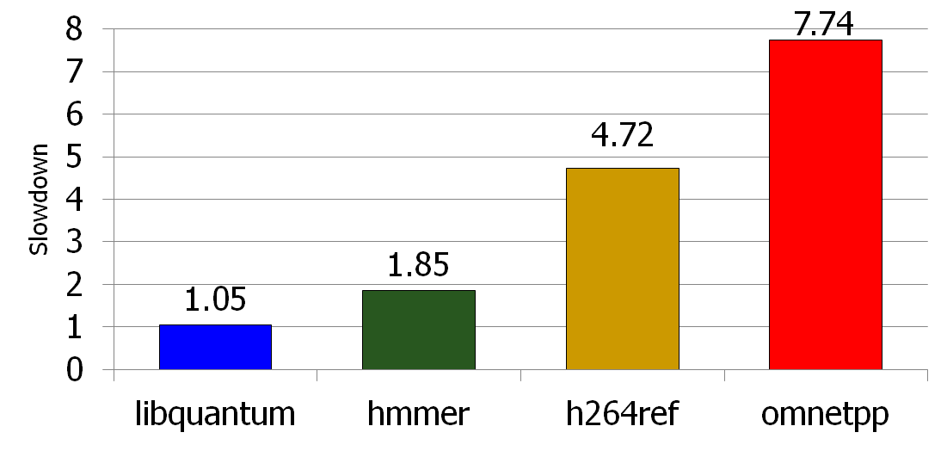
Problems due to Uncontrolled Interference
Main memory is the only shared resource
High priority
Memory performance hog
Low priority
Slowdown
Cores make
very slow
progress
Unfair slowdown of different threads
Low system performance
Vulnerability to denial of service
Priority inversion: unable to enforce priorities/SLAs

Slide 34
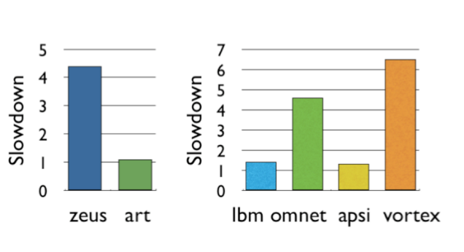
Problems due to Uncontrolled Interference
Unfair slowdown of different threads
Low system performance
Vulnerability to denial of service
Priority inversion: unable to enforce priorities/SLAs
Poor performance predictability (no performance isolation)
Uncontrollable, unpredictable system

Slide 35
Recap: Inter-Thread Interference in Memory
Memory controllers, pins, and memory banks are shared
Pin bandwidth is not increasing as fast as number of cores
Bandwidth per core reducing
Different threads executing on different cores interfere with each other in the main memory system
Threads delay each other by causing resource contention:
Bank, bus, row-buffer conflicts → reduced DRAM throughput
Threads can also destroy each other’s DRAM bank parallelism
Otherwise parallel requests can become serialized

Slide 36
Effects of Inter-Thread Interference in DRAM
Queueing/contention delays
Bank conflict, bus conflict, channel conflict, …
Additional delays due to DRAM constraints
Called “protocol overhead”
Examples
Row conflicts
Read-to-write and write-to-read delays
Loss of intra-thread parallelism
A thread’s concurrent requests are serviced serially instead of in parallel

Slide 37
Problem: QoS-Unaware Memory Control
Existing DRAM controllers are unaware of inter-thread interference in DRAM system
They simply aim to maximize DRAM throughput
Thread-unaware and thread-unfair
No intent to service each thread’s requests in parallel
FR-FCFS policy: 1) row-hit first, 2) oldest first
Unfairly prioritizes threads with high row-buffer locality
Unfairly prioritizes threads that are memory intensive (many outstanding memory accesses)

Slide 38
Solution: QoS-Aware Memory Request Scheduling
Resolves memory contention by scheduling requests
How to schedule requests to provide
High system performance
High fairness to applications
Configurability to system software
Memory controller needs to be aware of threads
Core
Core
Memory Controller
Memory
Core
Core

Slide 39
Stall-Time Fair Memory Scheduling
Onur Mutlu and Thomas Moscibroda, "Stall-Time Fair Memory Access Scheduling for Chip Multiprocessors" 40th International Symposium on Microarchitecture (MICRO),
pages 146-158, Chicago, IL, December 2007. Slides (ppt)
STFM Micro 2007 Talk

Slide 40
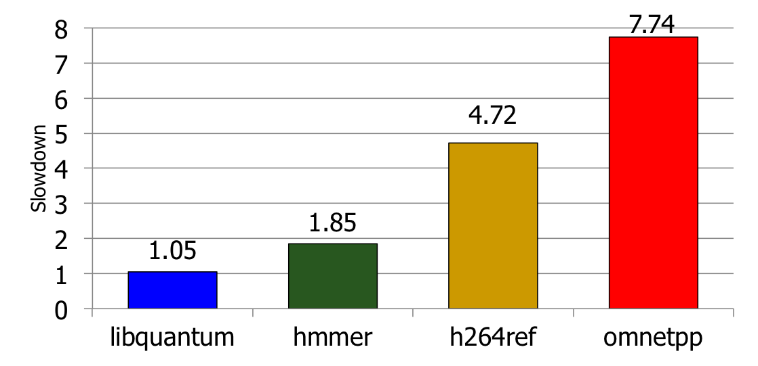
The Problem: Unfairness
Unfair slowdown of different threads
Low system performance
Vulnerability to denial of service
Priority inversion: unable to enforce priorities/SLAs
Poor performance predictability (no performance isolation)
Uncontrollable, unpredictable system

Slide 41
How Do We Solve the Problem?
Stall-time fair memory scheduling [Mutlu+ MICRO’07]
Goal: Threads sharing main memory should experience similar slowdowns compared to when they are run alone → fair scheduling
Also improves overall system performance by ensuring cores make “proportional” progress
Idea: Memory controller estimates each thread’s slowdown due to interference and schedules requests in a way to balance the slowdowns
Mutlu and Moscibroda, “Stall-Time Fair Memory Access Scheduling for Chip Multiprocessors,” MICRO 2007.

Slide 42
Stall-Time Fairness in Shared DRAM Systems
A DRAM system is fair if it equalizes the slowdown of equal-priority threads relative to when each thread is run alone on the same system
DRAM-related stall-time: The time a thread spends waiting for DRAM memory
ST_{shared}: DRAM-related stall-time when the thread runs with other threads
ST_{alone}: DRAM-related stall-time when the thread runs alone
Memory-slowdown = ST_{shared}/ST_{alone}
Relative increase in stall-time
Stall-Time Fair Memory scheduler (STFM) aims to equalize Memory-slowdown for interfering threads, without sacrificing performance
Considers inherent DRAM performance of each thread
Aims to allow proportional progress of threads
Notes:
Memory-slowdown is the relative increase in the DRAM-related stall-time due to interference from other threads
For example, if a thread’s DRAM related stall time is 1 hour when running alone, and its stall-time is 2 hours when it runs together with other threads,
Its memory-slowdown is said to be 2.
Give an example at the end: If a thread waits for DRAM 1 hour running by itself and this increases to 2 hours (its slowdown is 2), then a thread that waits for DRAM 2 hours, should now wait for DRAM 4 hours.
Each thread experiences the same slowdown compared to its baseline DRAM performance
The amount of time a thread spends waiting for DRAM memory
Extra time a thread requires to run because DRAM access is not instant
PROPORTIONALITY: Each thread makes the same amount of progress relative to its baseline performance. This is consistent with priority based scheduling mechanisms that allocate the same time quantum for equal-priority threads.
We define two values to compute slowdown.
Proportional slowdown (proportionate progress)
Fairness notion similar to SMT [Cazorla, IEEE Micro’04][Luo, ISPASS’01], SoEMT [Gabor, Micro’06], and shared caches [Kim, PACT’04]

Slide 43
STFM Scheduling Algorithm [MICRO’07]
For each thread, the DRAM controller
Tracks ST_{shared}
Estimates ST_{alone}
Each cycle, the DRAM controller
Computes Slowdown = ST_{shared}/ST_{alone} for threads with legal requests
Computes unfairness = MAX Slowdown / MIN Slowdown
If unfairness < α
Use DRAM throughput oriented scheduling policy
If unfairness ≥ α
Use fairness-oriented scheduling policy
(1) requests from thread with MAX Slowdown first
(2) row-hit first , (3) oldest-first
Notes:
Except for pathological cases, best achievable unfairness value is 1
Maximizes DRAM throughput if it cannot improve fairness
WORK CONSERVING: Does not waste useful bandwidth to improve fairness
If a request does not interfere with any other, it is scheduled

Slide 44
How Does STFM Prevent Unfairness?
T0: Row 0
T1: Row 5
T0: Row 0
T0: Row 0
T1: Row 111
T0: Row 0
T0: Row 0
T0: Row 0
T0: Row 0
T1: Row 16
Row 16
Row Buffer
Row 111
Row 0
Row 0
T0 Slowdown
1.00
1.04
1.04
1.07
1.10
1.03
T1 Slowdown
1.03
1.06
1.08
1.14
1.06
1.11
1.00
Unfairness
1.03
1.06
1.03
1.04
1.06
1.04
1.03
1.00
Data
α
1.05
Notes:
A pictorial example of how our solution prevents stream from being a memory performance hog
Our technique requires the DRAM controller to keep track of slowdowns for each thread and the unfairness value based on these slowdowns
Alpha parameter (maximum tolerable unfairness until the fairness-oriented scheduling policy kicks in) is set to 1.05 in this example
As stream’s requests are prioritized over rdarray’s, rdarray’s slowdown increases and hence unfairness increases
Once unfairness crosses the alpha value, our algorithm kicks in and uses the fairness-oriented scheduling policy
This policy prioritizes requests from the thread with the maximum slowdown (rdarray – thread 1)
Hence, rdarray’s requests do not indefinitely starve
Servicing rdarray’s request increases stream’s slowdown and keeps in check rdarray’s slowdown (thus reduces unfairness)
Therefore, when unfairness becomes tolerable again, our algorithm switches back to the baseline scheduling policy to maximize throughput (i.e. it schedules stream’s row hit requests first, and then the oldest requests)

Slide 45
STFM Pros and Cons
Upsides:
First algorithm for fair multi-core memory scheduling
Provides a mechanism to estimate memory slowdown of a thread
Good at providing fairness
Being fair can improve performance
Downsides:
Does not handle all types of interference
(Somewhat) complex to implement
Slowdown estimations can be incorrect

Slide 46
Parallelism-Aware Batch Scheduling
Onur Mutlu and Thomas Moscibroda, "Parallelism-Aware Batch Scheduling: Enhancing both
Performance and Fairness of Shared DRAM Systems” 35th International Symposium on Computer Architecture (ISCA),
pages 63-74, Beijing, China, June 2008. Slides (ppt)

Slide 47
Another Problem due to Interference
Processors try to tolerate the latency of DRAM requests by generating multiple outstanding requests
Memory-Level Parallelism (MLP)
Out-of-order execution, non-blocking caches, runahead execution
Effective only if the DRAM controller actually services the multiple requests in parallel in DRAM banks
Multiple threads share the DRAM controller
DRAM controllers are not aware of a thread’s MLP
Can service each thread’s outstanding requests serially, not in parallel
Notes:
Modern processors try to amortize the latency of DRAM requests by generating multiple outstanding requests
This concept is called memory-level parallelism.
Many techniques, such as OOO, non-blocking caches and runahead execution, are designed or used to tolerate long memory latencies by exploiting memory-level parallelism
These latency tolerance techniques are effective only if the DRAM controller actually services the multiple requests of a thread in parallel in DRAM banks
This is true in a single-threaded system since only one thread has exclusive access to all DRAM banks.
However, in a multi-core system, multiple threads share the DRAM controller.
Unfortunately, existing DRAM controllers are not aware of each thread’s memory level parallelism
As a result they can service each thread’s outstanding requests serially, not in parallel
Let’s take a look at why this happens.
-----------------------------------------
Assuming requests are to different banks
In a single core system this is fine because only one thread has exclusive access to all DRAM banks.
However, in a multi-core system, multiple threads shared the DRAM controller.
Unfortunately, DRAM controllers are unaware of a thread’s MLP. As a result, because threads can interfere with each other in the DRAM system, they can service each thread’s requests serially instead of in parallel.
Let’s take a look at why this happens.

Slide 48
Bank Parallelism of a Thread
2 DRAM Requests
Bank 0
Bank 1
Single Thread:
Thread A :
Compute
Stall
Compute
Bank 0
Bank 1
Thread A: Bank 0, Row 1
Thread A: Bank 1, Row 1
Bank access latencies of the two requests overlapped
Thread stalls for ~ONE bank access latency
Notes:
I will demonstrate this pictorially with an example.
Let’s say a thread A executes until it encounters 2 DRAM requests caused by two of its load instructions. These requests are sent to the DRAM controller. And, the controller services them by first scheduling the request to Bank 0 and then scheduling the request to Bank 1. While the requests are being serviced in parallel in the banks, the thread stalls (waiting for the data). Once the servicing of the requests completes, the thread can continue execution.
Since the requests were serviced in parallel in the two banks, bank access latencies of the two requests are overlapped. As a result, the thread stalls for approximately one bank access latency, instead of two bank access latencies.

Slide 49
Bank Parallelism Interference in DRAM
Baseline Scheduler:
Bank 0
Bank 1
2 DRAM Requests
A :
Compute
Stall
Stall
Compute
Bank 0
Bank 1
Thread A: Bank 0, Row 1
2 DRAM Requests
B:
Compute
Stall
Stall
Compute
Thread B: Bank 1, Row 99
Bank 1
Thread B: Bank 0, Row 99
Bank 0
Thread A: Bank 1, Row 1
Bank access latencies of each thread serialized
Each thread stalls for ~TWO bank access latencies
Notes:
What happens when we run two of these threads together in a dual-core system? Again, both threads execute until each encounters 2 DRAM requests. These requests are sent to the DRAM controller. Assume they arrive in the order shown. And the controller services them in the order they arrive.
The controller first takes Thread A’s request to Bank 0 and schedules it. It then schedules Thread B’s request to Bank 1. While these two requests are serviced in parallel, both threads stall.
Once the first request to Bank 0 is done, the controller takes Thread B’s request to bank 0 and schedules it. And it takes Thread A’s request to Bank 1 and schedules it. While these two requests are serviced in parallel, both threads stall.
Once the requests are complete, the threads continue computation.
In this case, because the threads’ requests interfered with each other in the DRAM system, the bank access latencies of each thread were serialized because the requests were serialized. As a result both threads stall for two bank access latencies instead of 1, which is what each thread experienced when running alone.
This is because the DRAM controller did not try to preserve the bank parallelism of each thread.

Slide 50
Parallelism-Aware Scheduler
Baseline Scheduler:
Bank 0
Bank 1
2 DRAM Requests
A :
Compute
Stall
Stall
Compute
Bank 0
Bank 1
2 DRAM Requests
Thread A: Bank 0, Row 1
B:
Compute
Stall
Stall
Compute
Thread B: Bank 1, Row 99
Bank 1
Thread B: Bank 0, Row 99
Bank 0
Parallelism-aware Scheduler:
Thread A: Bank 1, Row 1
2 DRAM Requests
A :
Compute
Stall
Compute
Saved Cycles
Average stall-time: ~1.5 bank access latencies
Bank 0
Bank 1
2 DRAM Requests
B:
Compute
Stall
Stall
Compute
Bank 0
Bank 1
Notes:
Can we do better than this? Let me describe what a parallelism aware scheduler would do.
This is the same example. The two threads compute until they each generate 2 DRAM requests, which arrive at the controller in the same order as before. The controller first takes Thread A’s request to Bank 0 and schedules it. But then, instead of servicing the requests in their arrival order, it realizes there is another request from Thread A to Bank 1 and if it schedules that one back to back with Thread A’s previous request, thread A’s request latencies would be overlapped.
Therefore, the controller takes Thread A’s request to Bank 1 and schedules it. While these two requests are serviced in parallel in the banks, both threads stall.
Once the request to Bank 0 is complete, the controller takes Thread B’s request to Bank 0 and schedules it. Later, it schedules Thread B’s request to Bank 1. While these two requests are being serviced, Thread B stalls (because it does not have the data it needs), but thread A can do useful computation! This is because its requests were serviced in parallel in the banks, instead of serially, and the thread has all the data it needs to do useful computation. As a result, the execution time of Thread A reduces compared to the baseline scheduler that was not aware of the threads’ bank parallelism.
Overall system throughput also improves because the average stall-time of the threads is 1.5 bank access latencies instead of 2. Instead of stalling, cores can make progress executing their instruction streams.

Slide 51
Parallelism-Aware Batch Scheduling (PAR-BS)
Principle 1: Parallelism-awareness
Schedule requests from a thread (to different banks) back to back
Preserves each thread’s bank parallelism
But, this can cause starvation…
Principle 2: Request Batching
Group a fixed number of oldest requests from each thread into a “batch”
Service the batch before all other requests
Form a new batch when the current one is done
Eliminates starvation, provides fairness
Allows parallelism-awareness within a batch
T1
T1
T2
T0
T2
T2
T3
T2
Batch
T0
T3
T2
T1
T1
T0
Bank 0
Bank 1
Mutlu and Moscibroda, “Parallelism-Aware Batch Scheduling,” ISCA 2008.
Notes:
Parallelism aware batch scheduling uses two key principles. The first principle is parallelism awareness. As I showed you before, a thread’s bank parallelism is improved by scheduling requests from a thread to different banks back to back. Unfortunately, doing this greedily can cause starvation because a thread whose requests are continuously scheduled back to back can keep on generating more requests and therefore deny service to other threads that are waiting to access the same bank.
To avoid this, we use a second principle, called request batching. With this, the controller groups a fixed number of oldest requests from each thread into a “batch”. And, it services the batch before all other requests. It forms a new batch when the current one is done.
Batching eliminates starvation of requests and threads, and provides fairness. It also allows parallelism of each thread to be optimized for within a batch.
Let’s take a look at how this works pictorially.
Multiple threads send requests to the DRAM controller. The controller groups these requests into a batch. Once a batch is formed any newly arriving requests are not included in the batch. Within the batch, the controller schedules each thread’s requests in parallel. It first takes TX’s requests and schedules them in parallel. Then it takes TY’s requests and schedules them in parallel. Note that incoming requests from T3 that are outside the batch are not serviced. Once all requests in the batch are serviced in a parallelism-aware manner, the controller forms a new batch with the requests in the memory request buffer.

Slide 52
PAR-BS Components
Request batching
Within-batch scheduling
Parallelism aware
Notes:
PAR-BS has two components, which I will describe in more detail. The first is request batching. Aside from guaranteeing starvation freedom and providing fairness, a batch provides a flexible substrate that enables aggressive scheduling optimizations (within the batch).
The second component is the within-batch scheduling component. Within a batch, any DRAM scheduling policy can be employed. And, this policy can be very aggressive and possibly unfair in the global sense. Because the overlying batching scheme ensures forward progress in each thread. In fact, we use a globally unfair shortest job first scheduling policy within a batch, to optimize each thread’s bank parallelism.

Slide 53
Request Batching
Each memory request has a bit (marked) associated with it
Batch formation:
Mark up to Marking-Cap oldest requests per bank for each thread
Marked requests constitute the batch
Form a new batch when no marked requests are left
Marked requests are prioritized over unmarked ones
No reordering of requests across batches: no starvation, high fairness
How to prioritize requests within a batch?
Notes:
To implement batching, Each memory request has a bit (called the marked bit) associated with it
When a batch is formed, the controller marks up to a Marking-Cap pending requests per bank for each thread. Marked requests constitute the batch. A new batch is formed when no marked requests are left.
The key idea is that marked requests are always prioritized over unmarked ones. Hence, there is no reordering of requests across batches: As a result, there is no starvation, and a high degree of fairness.
But how does the controller prioritize requests within a batch?

Slide 54
Within-Batch Scheduling
Can use any DRAM scheduling policy
FR-FCFS (row-hit first, then oldest-first) exploits row-buffer locality
But, we also want to preserve intra-thread bank parallelism
Service each thread’s requests back to back
Scheduler computes a ranking of threads when the batch is formed
Higher-ranked threads are prioritized over lower-ranked ones
Improves the likelihood that requests from a thread are serviced in parallel by different banks
Different threads prioritized in the same order across ALL banks
HOW?
Notes:
Within a batch, the controller can use any existing DRAM scheduling policy. For example, the baseline FR-FCFS policy is very good at exploiting row buffer locality.
However, in addition to exploiting row-buffer locality, we also want to preserve intra-thread bank parallelism. As I showed you before, this can be accomplished by servicing each thread’s requests back to back
To do so, the DRAM scheduler computes a ranking of threads when the batch is formed
And it prioritizes requests that belong to higher-ranked threads over those that belong to lower ranked ones
This Improves the likelihood that requests from a thread are serviced in parallel by different banks
Because Different threads prioritized in the same order (the RANK ORDER) across ALL banks
But how does the scheduler compute this ranking?

Slide 55
How to Rank Threads within a Batch
Ranking scheme affects system throughput and fairness
Maximize system throughput
Minimize average stall-time of threads within the batch
Minimize unfairness (Equalize the slowdown of threads)
Service threads with inherently low stall-time early in the batch
Insight: delaying memory non-intensive threads results in high slowdown
Shortest stall-time first (shortest job first) ranking
Provides optimal system throughput [Smith, 1956]*
Controller estimates each thread’s stall-time within the batch
Ranks threads with shorter stall-time higher
* W.E. Smith, “Various optimizers for single stage production,” Naval Research Logistics Quarterly, 1956.
Notes:
The thread ranking scheme affects system throughput and fairness
A good ranking scheme should achieve two objectives.
First, it should maximize system throughput
Second, it should minimize unfairness; in other words it should balance the slowdown of the threads compared to when each is run alone.
These two objectives call for the same ranking scheme, as I will show soon.
Maximizing system throughput is achieved by minimizing the average stall-time of the threads within the batch (as I showed in the earlier example). By minimizing the average stall time, we maximize the amount of time the system spends on computation rather than waiting for DRAM accesses.
Minimizing unfairness is achieved by servicing threads with inherently low stall-time early in the batch, The insight is that if a thread has low stall time to begin with (if it is not intensive) delaying that thread would result in very high slowdown compared to delaying a memory-intensive thread.
To achieve both objectives, we use the “shortest job first” principle. Shortest job first scheduling has been proven to provide the optimal throughput in generalized machine scheduling theory. The controller estimates each thread’s stall-time within the batch (assuming the thread is run alone). And, it ranks a thread higher if the thread has a short stall time.

Slide 56
Shortest Stall-Time First Ranking
Maximum number of marked requests to any bank (max-bank-load)
Rank thread with lower max-bank-load higher (~ low stall-time)
Total number of marked requests (total-load)
Breaks ties: rank thread with lower total-load higher
T3
 | max-bank-load | total-load
T0 | 1 | 3
T1 | 2 | 4
T2 | 2 | 6
T3 | 5 | 9
T3
T3
T2
T3
T3
T1
T0
T2
T0
T2
T2
T1
T2
T3
T1
T0
T3
T1
T3
T2
T3
Bank 0
Bank 1
Bank 2
Bank 3
Ranking:
T0 > T1 > T2 > T3
Notes:
How is this exactly done? The controller keeps track of two values for each thread. First, the maximum number of marked requests from the thread to any bank. This is called max-bank-load. A lower value of this correlates with low stall time (and less memory intensiveness). As a result the scheduler ranks a thread with lower max-bank-load higher than a thread with higher max-bank load.
If the max-bank-load of the two threads are equal, the scheduler uses another value it keeps track of to break the ties. It keeps the total number of requests in the batch from each thread. This is called total-load. If a thread has lower total-load it is less intensive, therefore it is ranked higher.
Let’s take a look at these concepts with an example. Assume these are the requests within the batch.
T0 has at most 1 request to any bank, so its max-bank-load is 1. Its total-load is 3 since it has total 3 marked requests.
T1 has at most 2 requests to any bank so its max-bank-load is 2. Its total load is 6.
T2 similarly has a max-bank-load of 2, but its total load is higher.
Finally, T3 has a maximum of 5 requests to Bank 3. Therefore, its max-bank load is 5.
Because T1 has the smallest max-bank-load, it is ranked highest. The scheduler ranks T1 higher than T2 because T1 has fewer total requests. The most memory intensive thread, T2 is ranked the lowest.
----------------------------
Insight: Memory-intensive threads can be delayed more within a batch since their baseline stall-time is high
How do you break the ties? A thread with lower total-load is ranked higher
Goal: Finish non-intensive threads first and fill in the gaps in parallelism as much as possible
Shortest job first within a batch might seem unfair, but remember the batch boundaries. Less intensive threads will be penalized across batches because if their requests are not marked, they cannot be serviced. Shortest job first balances this delay caused to the less intensive threads
Thread 0 has at most one request to any bank
Thread 1 has at most 2: it has two requests to Bank 0.
Thread 2 has at most 2 as well.
Thread 3 has max number of requests to Bank 3 (5 reqs)

Slide 57
Example Within-Batch Scheduling Order
Baseline Scheduling
Order (Arrival order)
T3
7
PAR-BS Scheduling
Order
T3
7
T3
6
T3
6
T3
T2
T3
T3
5
T3
T3
T3
T3
5
4
4
T1
T0
T2
T0
Time
T3
T2
T2
T3
Time
T2
T2
T1
T2
3
T2
T2
T2
T3
3
T3
T1
T0
T3
2
T1
T1
T1
T2
2
T1
T3
T2
T3
1
T1
T0
T0
T0
1
Bank 0
Bank 1
Bank 2
Bank 3
Bank 0
Bank 1
Bank 2
Bank 3
Ranking: T0 > T1 > T2 > T3
T0 | T1 | T2 | T3
4 | 4 | 5 | 7
T0 | T1 | T2 | T3
1 | 2 | 4 | 7
Stall times
Stall times
AVG: 5 bank access latencies
AVG: 3.5 bank access latencies
Notes:
How does this ranking affect the scheduling order? Let’s take a look at this pictorially.
First, let’s look at the baseline scheduler. I will show the time at which the requests are serviced, where time is expressed abstractly in terms of bank access latency. In the baseline scheduler, the batched requests are serviced in their arrival order. As a result, the last request of T0 is serviced after 4 bank access latencies, the last request of T1 is also serviced after 4 bank access latencies. Consequently, the average stall time of the threads is approximately 5 bank access latencies within this batch of requests.
If we use PAR-BS to rank the threads, the scheduler will prioritize requests based on their thread-rank order, which I showed before. It prioritizes T0’s requests first (as shown in the ranking order). As a result, T0’s requests complete after 1 bank access latency. T1’s requests are serviced after 2 bank access latencies. T2’s requests are serviced after 4 bank access latencies.
Note that the bank parallelism of each thread is preserved as much as possible. Because of this, the average stall time reduces by 30%. Thus, system throughput improves.
Also note that, to keep this example simple, I assumed there are no row-buffer hits. A more complicated example with row-buffer hits is provided in the paper, and I encourage you to look at it.
--------------------------------------
Time is in bank access latencies (note that this is an approximation to demonstrate the idea… real DRAM system is much more complex than this…)
Last request from a thread is scheduled at TIME

Slide 58
Putting It Together: PAR-BS Scheduling Policy
PAR-BS Scheduling Policy
(1) Marked requests first
(2) Row-hit requests first
(3) Higher-rank thread first (shortest stall-time first)
(4) Oldest first
Three properties:
Exploits row-buffer locality and intra-thread bank parallelism
Work-conserving: does not waste bandwidth when it can be used
Services unmarked requests to banks without marked requests
Marking-Cap is important
Too small cap: destroys row-buffer locality
Too large cap: penalizes memory non-intensive threads
Mutlu and Moscibroda, “Parallelism-Aware Batch Scheduling,” ISCA 2008.
Batching
Parallelism-aware
within-batch
scheduling
Notes:
The resulting scheduling policy of our mechanism is based on four simple prioritization rules.
Marked requests are prioritized over others. This is the batching component.
Within a batch, row-hit requests are prioritized over others to exploit row-buffer locality (as in FR-FCFS). Then, higher-ranked threads’ requests are prioritized over lower ranked threads’ requests (to preserve each thread’s bank parallelism). Finally all else being equal, older requests are prioritized over others.
This scheduling policy has three properties.
First, it exploits both row-buffer locality and intra-thread bank parallelism. I assumed no row buffer hits in the previous example, to keep it simple, but this is taken into account in our scheduling algorithm. There is a balance between exploiting row buffer locality and bank parallelism, and our scheduling algorithm tries to achieve this balance. An example with row hits is provided in the paper.
Second, it is work conserving. It services unmarked requests in banks without marked requests.
Third, and I will not go into much detail on this, Marking-Cap is the most important parameter. Remember that the Marking-Cap determines how many requests from each thread to each bank can be admitted into a batch. If the cap is too small, too few requests from each thread are admitted into the batch. As a result, a thread’s row buffer locality cannot be exploited. If the cap is too large too many requests from intensive threads enter the batch, which slows down non-intensive threads.
Many other similar trade-offs are analyzed in the paper and I encourage you to read it.

Slide 59
Hardware Cost
<1.5KB storage cost for
8-core system with 128-entry memory request buffer
No complex operations (e.g., divisions)
Not on the critical path
Scheduler makes a decision only every DRAM cycle
Notes:
The implementation of PAR-BS is relatively simple. It requires three pieces of logic. Marking logic and thread ranking logic are utilized only when a new batch is formed. Extensions to request prioritization logic are needed to take into account the marked status and the thread-rank of each request.
There are no complex operations and the logic is not on the critical path of execution.
Our implementation requires less than 1.5KB storage cost within a reasonably large system with 8 cores.
More details are provided in the paper.

Slide 60
Unfairness on 4-, 8-, 16-core Systems
Unfairness = MAX Memory Slowdown / MIN Memory Slowdown [MICRO 2007]
Notes:
This graph compares the five schedulers in terms of unfairness averaged over all workloads run on the 4, 8, and 16 core systems. Unfairness is computed as the max memory slowdown in the system divided by the minimum memory slowdown in the system. PAR-BS reduces unfairness significantly compared to the best previous scheduler, STFM, on all systems.
We conclude that the combination of batching and shortest stall-time first within batch scheduling provides good fairness without the need to explicitly estimate each thread’s slowdown and adjust scheduling policy based on that.

Slide 61
System Performance
Notes:
This graph compares the system performance provided by the five schedulers. Performance is normalized to that of the baseline FR-FCFS scheduler. PAR-BS also improves system performance compared to the best previous scheduler, STFM, on all systems. In the 4-core system, PAR-BS provides an 8.3% performance improvement. The main reason is that PAR-BS improves each thread’s bank level parallelism: as a result, it reduces the average stall time per each request by 7.1% in the four core system (from 301 cycles to 281 cycles)

Slide 62
PAR-BS Pros and Cons
Upsides:
First scheduler to address bank parallelism destruction across multiple threads
Simple mechanism (vs. STFM)
Batching provides fairness
Ranking enables parallelism awareness
Downsides:
Does not always prioritize the latency-sensitive applications

Slide 63
TCM: Thread Cluster Memory Scheduling
Yoongu Kim, Michael Papamichael, Onur Mutlu, and Mor Harchol-Balter, "Thread Cluster Memory Scheduling:
Exploiting Differences in Memory Access Behavior" 43rd International Symposium on Microarchitecture (MICRO),
pages 65-76, Atlanta, GA, December 2010. Slides (pptx) (pdf)
TCM Micro 2010 Talk

Slide 64
Throughput vs. Fairness
24 cores, 4 memory controllers, 96 workloads
Better fairness
System throughput bias
Better system throughput
Ideal
Fairness bias
No previous memory scheduling algorithm provides both the best fairness and system throughput
Notes:
The problem is that previously proposed scheduling algorithms are biased.
Shown here is a plot, where the x-axis is weighted speedup, a metric of system throughput and system throughput increases as you move towards the right on the x-axis.
The y-axis is maximum slowdown, which is the slowdown of the most unfairly treated thread within a workload. Correspondingly, fairness increases as you move downwards on the y-axis.
Ideally, a memory scheduling algorithm would be situated towards the lower right part of the graph where fairness and system throughput are both high.
However, some previous algorithms are biased towards system throughput, whereas some are biased towards fairness, while others are optimized for neither.
The takeaway is that no previous memory scheduling algorithm provides both the best fairness and system throughput.

Slide 65
Throughput vs. Fairness
Throughput biased approach
Fairness biased approach
Prioritize less memory-intensive threads
Take turns accessing memory
Good for throughput
Does not starve
thread A
less memory intensive
thread B
higher
priority
thread C
thread A
thread B
thread C
not prioritized ➔
reduced throughput
starvation ➔ unfairness
Single policy for all threads is insufficient
Notes:
So why do previous algorithms fail?
On the one hand there is the throughput biased approach that prioritizes less memory-intensive threads.
Servicing memory requests from such threads allow them to make progress in the processor, increasing throughput.
However, the most memory-intensive thread, thread C, remains persistently deprioritized and and becomes prone to starvation causing large slowdowns and, ultimately, unfairness.
On the other hand there is the fairness biased approach where threads take turns accessing the memory.
In this case, the most memory-intensive thread does not starve.
However, the least memory-intensive thread, thread A, is not prioritized, leading to reduced throughput.
As you can see, a single policy applied to all threads is insufficient since different threads have different memory access needs.

Slide 66

Achieving the Best of Both Worlds
higher
priority
For Throughput
Prioritize memory-non-intensive threads
thread
thread
thread
For Fairness
thread
Unfairness caused by memory-intensive being prioritized over each other
Shuffle thread ranking
Memory-intensive threads have different vulnerability to interference
Shuffle asymmetrically
thread
thread
thread
thread
thread
thread
thread
thread
Notes:
So how do we achieve the best of both worlds? Our algorithm is based on the following insights:
First, we would like to prioritize the memory-non-intensive threads to increase system throughput.
Doing so does not degrade unfairness, since memory-non-intensive threads are inherently “light” and rarely cause interference for the memory-intensive threads.
For fairness, we discovered that unfairness is usually caused when one memory-intensive thread is prioritized over another.
As we’ve seen, the most deprioritized thread can starve.
To address this problem, we would like to shuffle their priority so that no single thread is persistently prioritized over another thread.
However, memory-intensive threads are not created equal.
They have different vulnerability to memory interference.
To address their differences, shuffling should be performed in an asymmetric manner.

Slide 67
Thread Cluster Memory Scheduling [Kim+ MICRO’10]
Group threads into two clusters
Prioritize non-intensive cluster
Different policies for each cluster
higher
priority
Memory-non-intensive
Non-intensive
cluster
thread
Throughput
thread
thread
thread
thread
thread
Prioritized
higher
priority
thread
thread
thread
thread
Threads in the system
Memory-intensive
Intensive cluster
Fairness
Notes:
Our algorithm, Thread Cluster Memory Scheduling, first groups threads into two clusters.
Among the threads executing in the system, some are memory-non-intensive whereas some are memory-intensive.
We isolate the memory-non-intensive threads into the non-intensive cluster and the memory-intensive threads into the intensive cluster.
This is so that we can apply different policies for different threads.
Subsequently, we prioritize the non-intensive cluster over the intensive cluster since the non-intensive threads have greater potential for making progress IN THEIR CORES [ONUR].
Finally, we apply different policies within each cluster, one optimized for throughput and the other for fairness.

Slide 68
Clustering Threads
Step1 Sort threads by MPKI (misses per kiloinstruction)
higher
MPKI
thread
thread
thread
thread
thread
thread
Non-intensive
cluster
Intensive
cluster
αT
T
α < 10% ClusterThreshold
T = Total memory bandwidth usage
Step2 Memory bandwidth usage αT divides clusters
Notes:
To group threads into two clusters, we first sort threads according to their MPKI, which stands for last-level cache-misses per kiloinstruction and is a metric of memory intensity.
After sorting, the leftmost thread is the thread with the lowest MPKI.
We then define a quantity called T, which is the total memory bandwidth usage across all threads.
Second, we form the non-intensive cluster by including threads whose bandwidth usage sums up to a certain fraction of the memory bandwidth usage.
That fraction is defined by a parameter called the ClusterThreshold. I will show later in the presentation how adjusting this parameter we can trade off between throughput and fairness.
Lastly, the remaining threads become the intensive cluster.

Slide 69
TCM: Quantum-Based Operation
Previous quantum (~1M cycles)
Current quantum
(~1M cycles)
Time
Shuffle interval
(~1K cycles)
During quantum:
Monitor thread behavior
Memory intensity
Bank-level parallelism
Row-buffer locality
Beginning of quantum:
Perform clustering
Compute niceness of intensive threads
Notes:
Clustering is performed at regular time intervals called quanta.
THIS IS DONE [ONUR] to account for phase changes in threads’ memory access behavior.
During A [ONUR] quantum, TCM monitors each thread’s memory access behavior:
memory intensity, bank-level parallelism, and row-buffer locality.
At the beginning of the next quantum, TCM is invoked to perform clustering and calculate niceness for the intensive threads.
Throughout the quantum, shuffling of the intensive threads is performed periodically.

Slide 70
TCM: Scheduling Algorithm
Highest-rank: Requests from higher ranked threads prioritized
Non-Intensive cluster > Intensive cluster
Non-Intensive cluster: lower intensity ➔ higher rank
Intensive cluster: rank shuffling
Row-hit: Row-buffer hit requests are prioritized
Oldest: Older requests are prioritized
Notes:
To bring it all together, TCM comprises three simple request prioritization rules.
The first is the highest-rank rule, where requests from higher ranked threads are prioritized.
The intensive cluster is prioritized over the non-intensive cluster TO IMPROVE SYSTEM [ONUR] throughput.
Within the intensive cluster, threads are assigned higher rank in the order of decreasing intensity. This, again, is to increase SYSTEM [ONUR] throughput.
Within the non-intensive cluster, the rank of threads are periodically shuffled and does not stay constant, TO ACHIEVE FAIRNESS [ONUR].
As a tie-breaker, the second rule is row-hit where row-buffer hitting requests are prioritized.
Lastly, all else being the same, we prioritize the oldest request.

Slide 71
TCM: Throughput and Fairness
24 cores, 4 memory controllers, 96 workloads
Better fairness
Better system throughput
TCM, a heterogeneous scheduling policy,
provides best fairness and system throughput
Notes:
This figure shows the performance of the four previous scheduling algorithms in addition to TCM, averaged over 96 workloads.
FRFCFS has low system throughput and fairness.
STFM and PAR-BS is biased towards fairness, while ATLAS is biased towards system throughput.
TCM lies towards the lower right part of the figure and provides the best fairness and system throughput.
Compared to ATLAS, TCM provides approx 5% better throughput and 39% better fairness.
Compared to PAR-BS, TCM provides approx 5% better fairness and 8% better throughput.

Slide 72
TCM: Fairness-Throughput Tradeoff
When configuration parameter is varied…
Better fairness
FRFCFS
STFM
Better system throughput
ATLAS
PAR-BS
TCM
Adjusting ClusterThreshold
TCM allows robust fairness-throughput tradeoff

Slide 73
TCM Pros and Cons
Upsides:
Provides both high fairness and high performance
Caters to the needs for different types of threads (latency vs. bandwidth sensitive)
(Relatively) simple
Downsides:
Scalability to large buffer sizes?
Robustness of clustering and shuffling algorithms?

